Slide 1
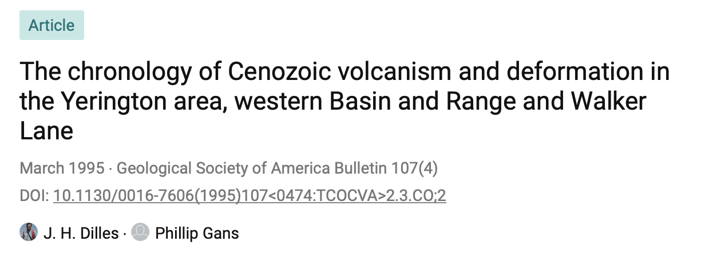
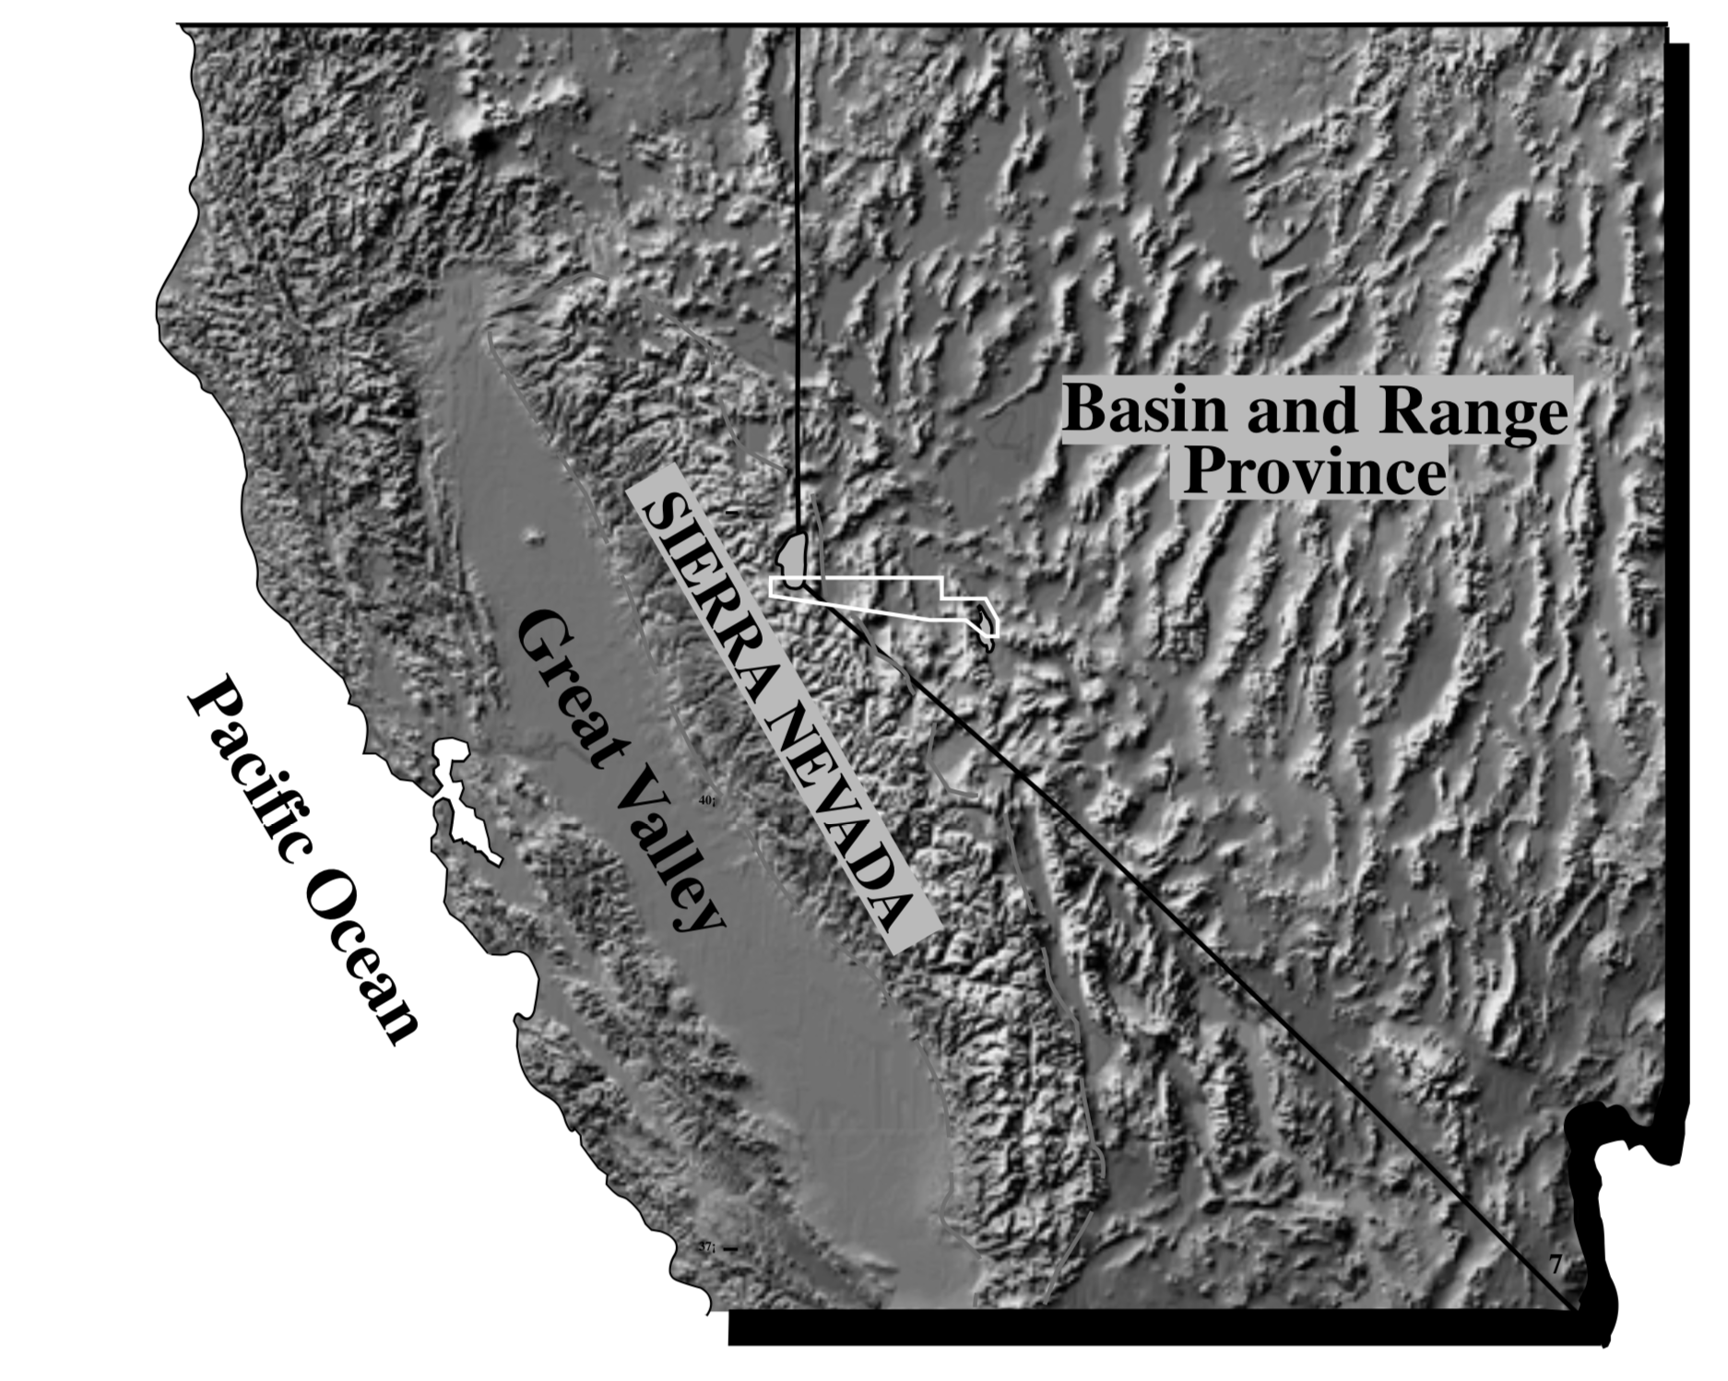
Two-Phase Westward Encroachment of Basin and Range Extension into the Northern Sierra Nevada
B. E. Surpless, et al., 2002
Presented by Angelica Rodriguez
Notes:
On first order- unextended SN crustal block on W separated from the highly extended crust on the East
In more detail- A broad structural transition zone between the two provinces, where magnitude of extension increases from west to east
Motivation: little work done (in 2002) at the northern transition between SN and BR one paper (Dilles and Gans 1995) suggested a 100km zone of deformation in to the SN since 15ma based on distribution and age of synextensional deposits.

Slide 2
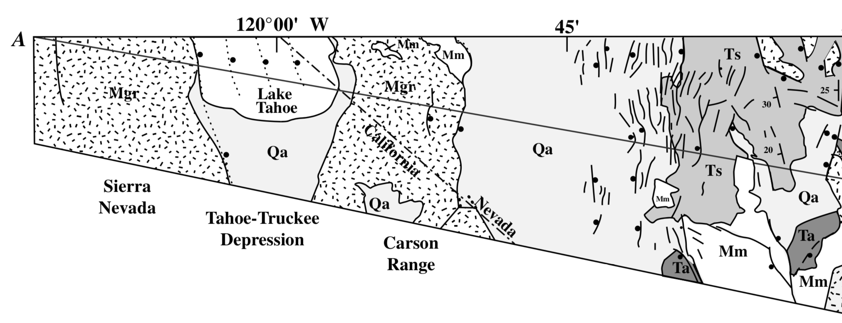
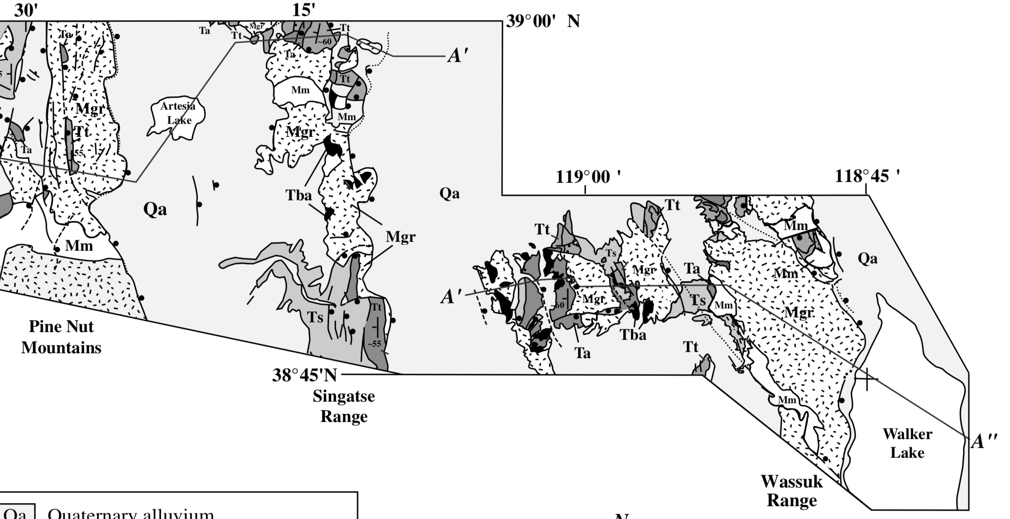
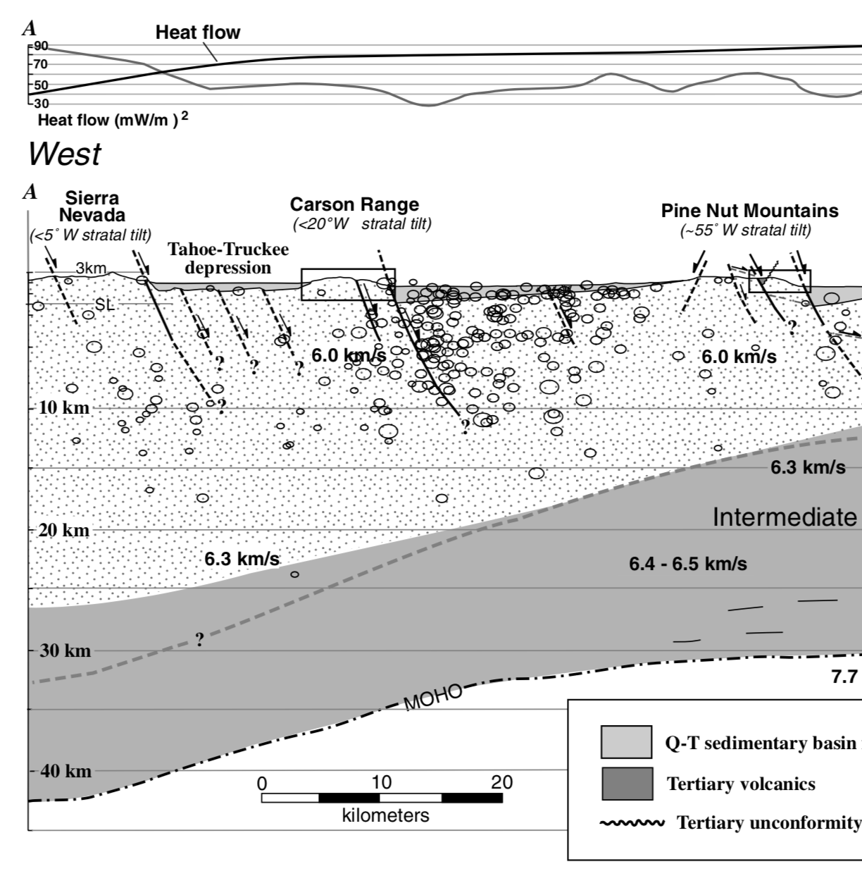
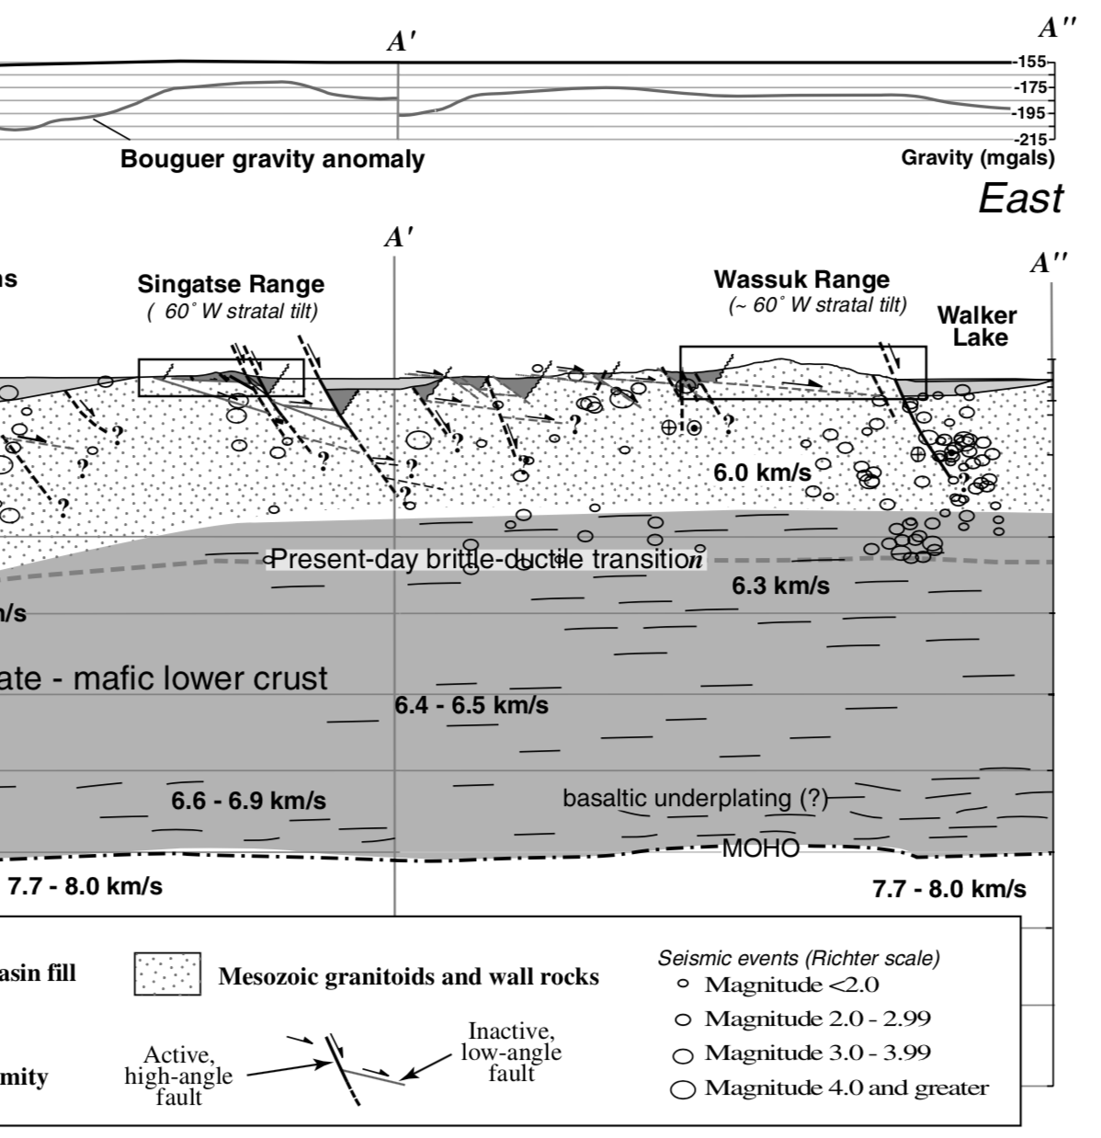
Geologic, Geophysical, and Thermo-Chronological data constrain the timing of exhumation and spatial distribution of faults through time as well as the thermal structure of the crust at the beginning of extension.
Unextended
B. E. Surpless, et al., 2002
Extended
Notes:
On first order in this cross section we see that the crust his unextended to the West and extended to the East
Evidence includes:
Heat flow is a function of how close the asthenosphere is to the surface (crust thins to east; heat flow gets higher)
Bouguer gravity anomaly - shows the effect of different rock densities at the surface
This cross section also tells us
Contemporary Seismicity- indicates that there is seismic activity along the normal and right lateral faults on the western margin of the basin and range indicating that extension is encroaching to the west.
Exhumed Fault Blocks- expose intact sections of the upper crust that can bee studied with thermochronology

Slide 3
Geophysical
Heat Flow Values Decrease
Earthquake Foci Depth Increases
Total Lithospheric Thickness
80Km
60Km
Unextended
B. E. Surpless, et al., 2002
Extended
Notes:
Geophysical data typical of extend crust includes:
subhorizontal reflectivity in the lower crust
Low relief topography of the MOHO discontinuity
Thin crust
Three lines of geophysical evidence for transitional boundary between two provinces

Slide 4
Geology
Composed of Middle Jurassic and Cretaceous Granodiorite to Granite
Cenozoic sedimentary and volcanic units unconformably overlie mesozoic igneous and metamorphic basement (Timing, and Tilting)
Magnitude of faulting decreases to West
B. E. Surpless, et al., 2002
Notes:
From East to West major fault controlled structures include ...names
Units are composed of middle jurassic and cretaceous granodiorite to granite
Cenozoic sed and vol rocks unconformably overlie mesozoic igneous and metamorphic basement
They are used to determine timing of fault motion, magnitude and direction of of tilting and displacements across faults.

Slide 5
Geology East
Lincoln Flat Hornblende Andesite 14.8-15.1 Ma (WR); 15.0-13.8 Ma (SR)
Basaltic andesite
14.4 Ma
~20°-30° tilt
Wassuk Range
~14Ma Extensional timing and magnitude constrained by pre extensional and synextensional andesite and basaltic andesite flows.
14-7Ma Sedimentary units (dip ~24°-40°).
7Ma Basaltic andesite flows (dip~8°-12°).
Total: 60° cumulative westward fault block tilt
Singatse Range
Extension continued to 13-12.6Ma (increasing dip to 40°-45°)
Tilt on fault surface increased tilt by 10°-15°
Total: >60° cumulative westward fault block tilt
B. E. Surpless, et al., 2002
Notes:
Composed of Jurassic and Cretaceous quartz monzonite; unconformably overlain by Oligocene ash flow tuffs
Ages are from Ar/Ar

Slide 6
Geology West
Oligocene Hartford Hill Silicic Ash Flow Tuff dips ~55°
Genoa frontal fault
Henry and Perkins [2001] showed evidence for extension to the north at 12Ma
Crosscutting relationships bracket the initiation of extension between 7Ma-2Ma
Gravity data indicates Carson Valley dips to West with deepest part in the West
B. E. Surpless, et al., 2002
Notes:
Composed of Cretaceous granodiorite to granite unconformably overlain by minor tertiary volcanics
Oligocene H H S A F T is the only marker bed for the range
Shallow tilts to the West suggest a poorly exposed middle Miocene fault zone
Genoa frontal fault accomidates 10° dip defined by contemporary seismicity

Slide 7
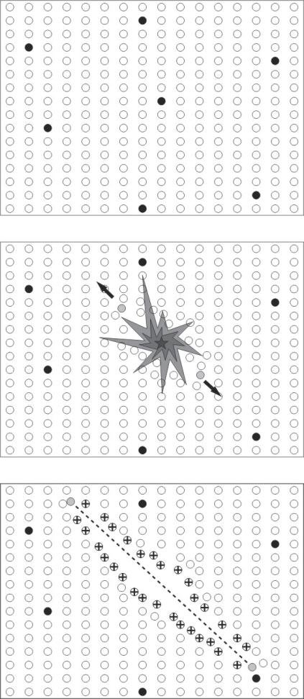
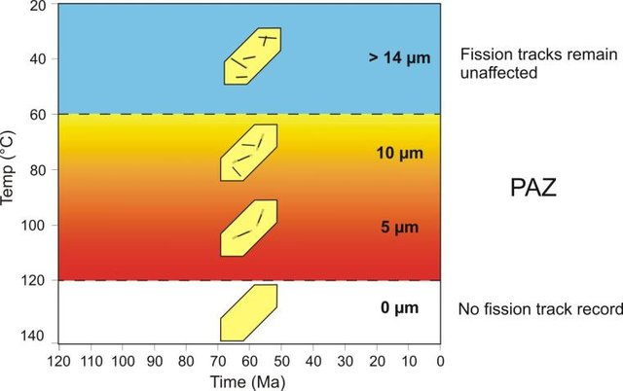
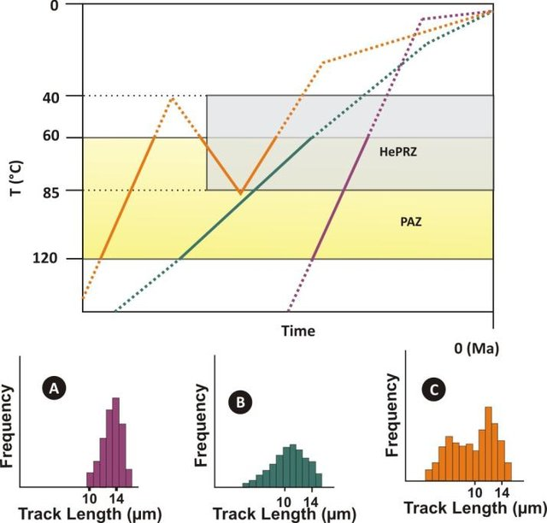
Apatite Fission Track Thermochronology
238U in Apatite Crystal Lattice
Fission tracks remain unaffected
Partial Annealing Zone
No record
Doepke., 2017
Notes:
AFT used to determine timing of cooling and exhumation of rocks in structurally intact exhumed footwalls of major extensional fault systems.
Based on the decay of 238U, energy is released during movement causing a fission track
At high temperatures the crystal can repair itself, at moderate temepratures it can partially repair and at low temperatures it cannot repair itself
Three possible Time- Temperature paths with three different track length distributions
Narrow and high slope- rapid cooling
Wide distribution - slow cooling
Bimodal distribution - indicates reheating of the sample

Slide 8
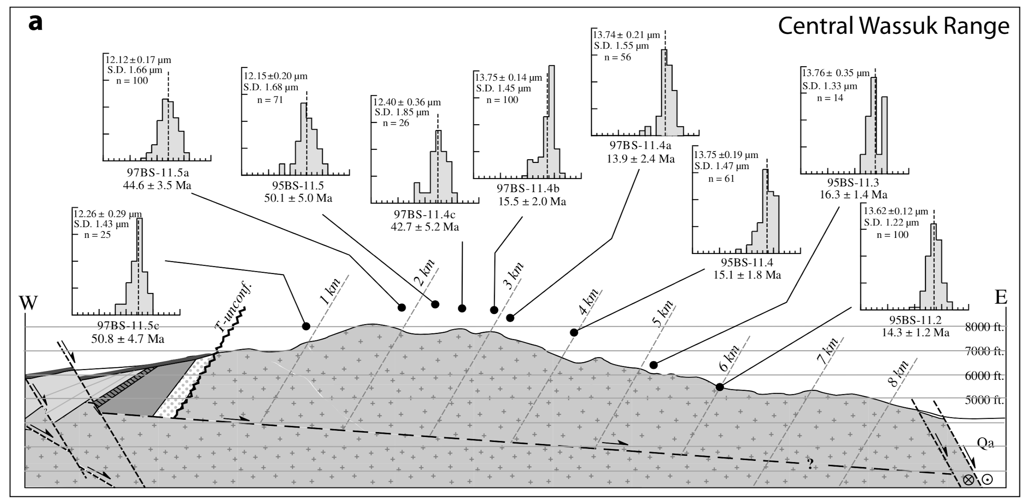
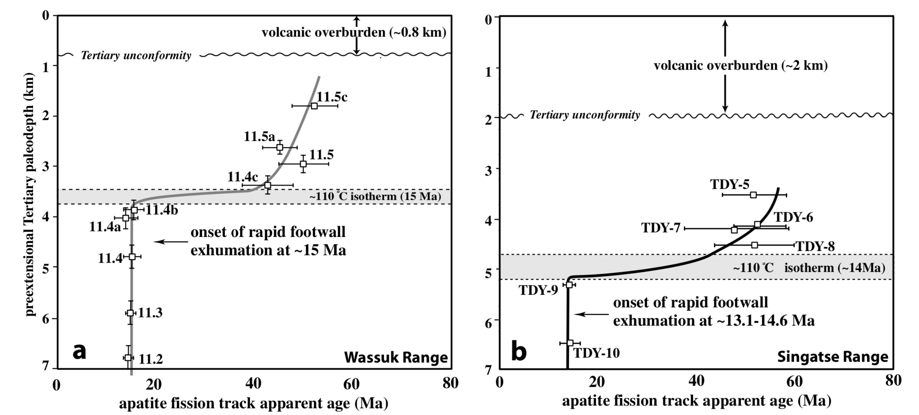
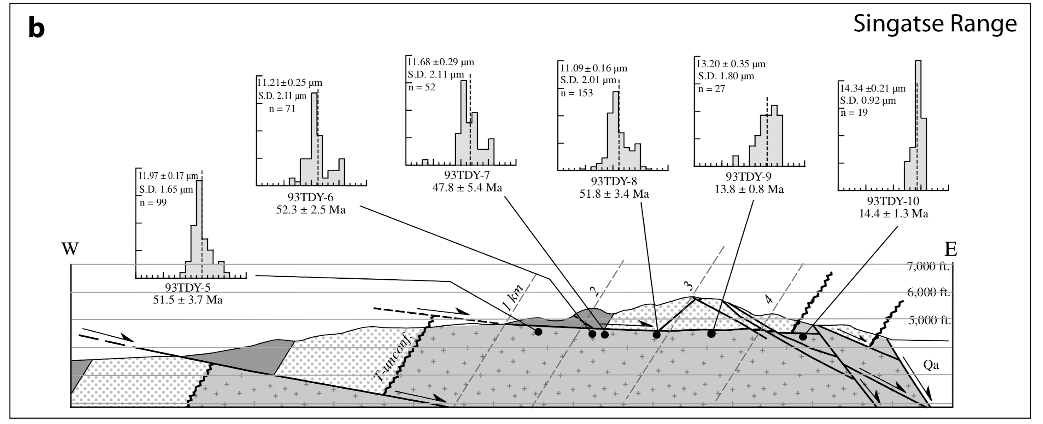
Geothermal gradient = 27°±5°C km^-1
Geothermal gradient = 20°±5°C km^-1
B. E. Surpless, et al., 2002
Notes:
LEFT
Ages decrease with preextensional depth
Unimodal narrow track lengths indicating rapid cooling
RIGHT
Ages plotted against prextensional depth
Overall, corroberates structural data that rapid cooling occured @15Ma in WR and @14Ma in Singatse Range
Inflection in paleodepth defines the geotherm
In the wassuk range additional data (relief, seismicity, and additional thermochronology) indicates post 5ma cooling and exhumation possibly related to the walker lane
Generally, data support large magnitude miocene extnesion along east dipping faults

Slide 9
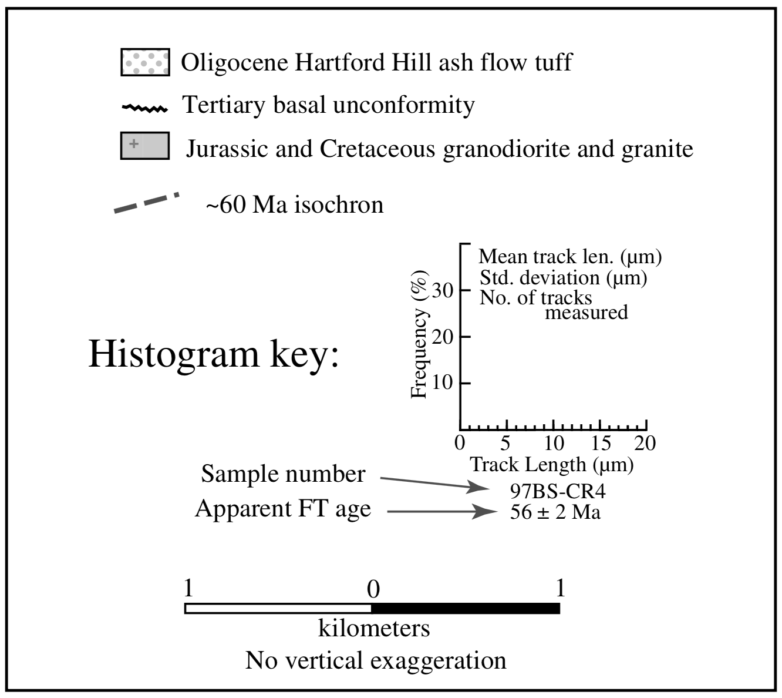
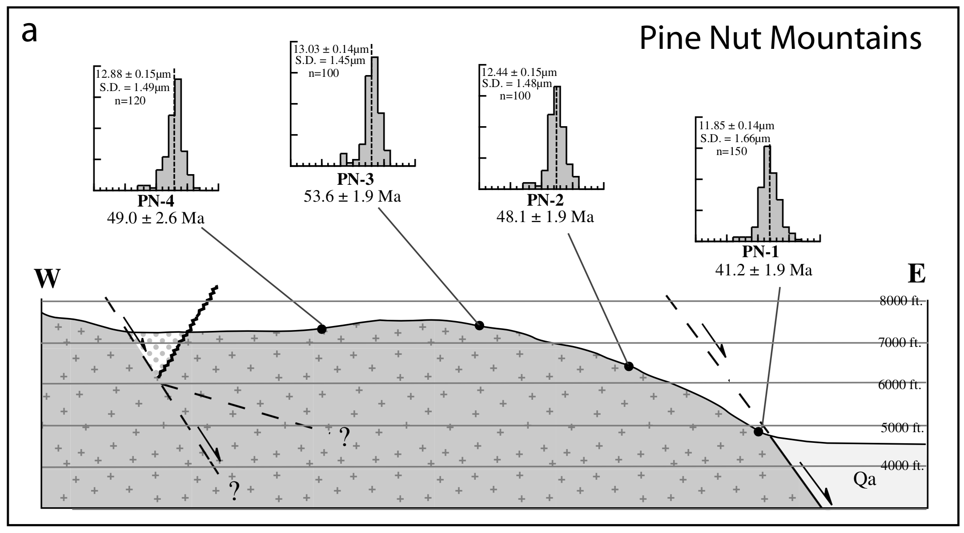
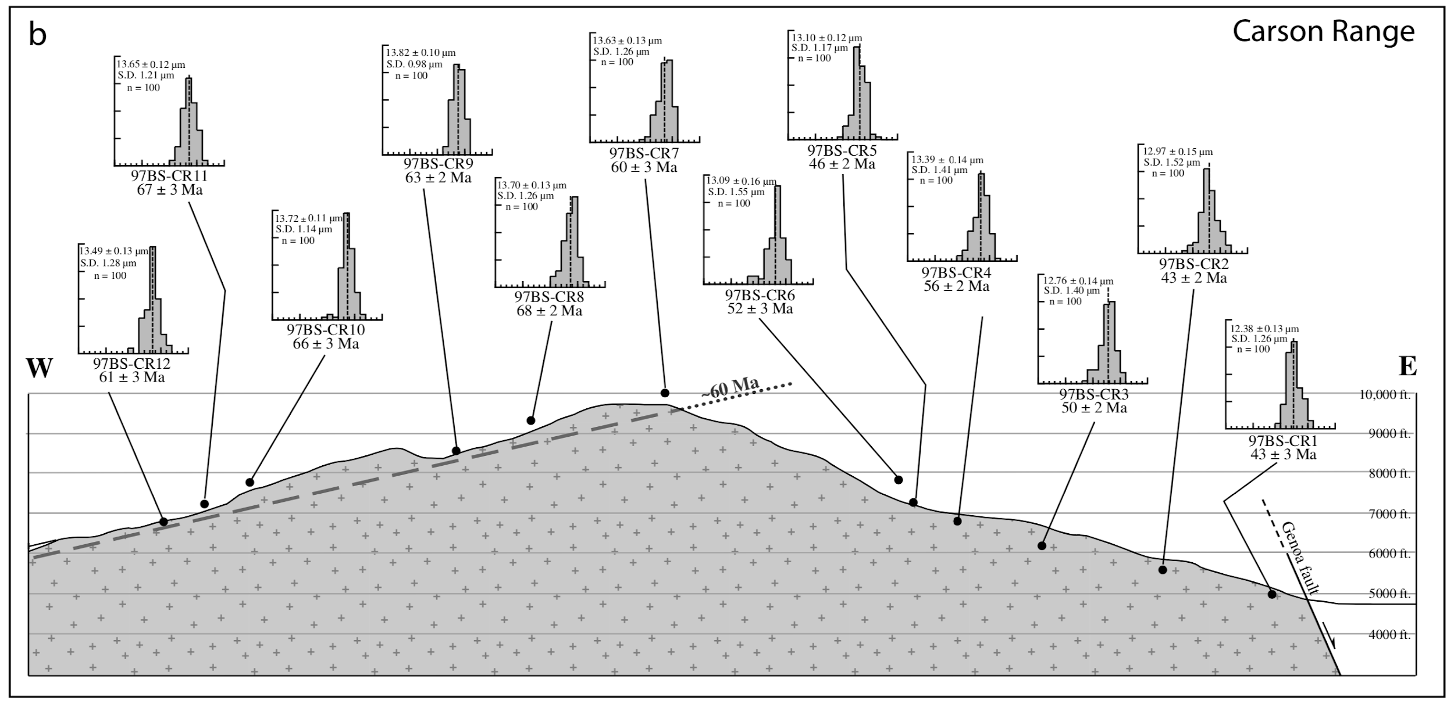
B. E. Surpless, et al., 2002
Notes:
Due to the minimal exhumed crust, there is no detailed thermal chronological work on the Western Ranges (Pine Nut and Carson Range)
Were able to determine the rocks came from at or near the top of the PAZ due to the decreasing mean track length, decreasing age, and increase in track length
Were able to better quantlfy tilt in the carson range on the western part of the range samples define a 60Ma isotherm that dips at 15°… posibly the west tahoe fault
This finding suggests that the Carson range is a west tilted half block and the tahoe truckee depression is an asymetric half grabben

Slide 10
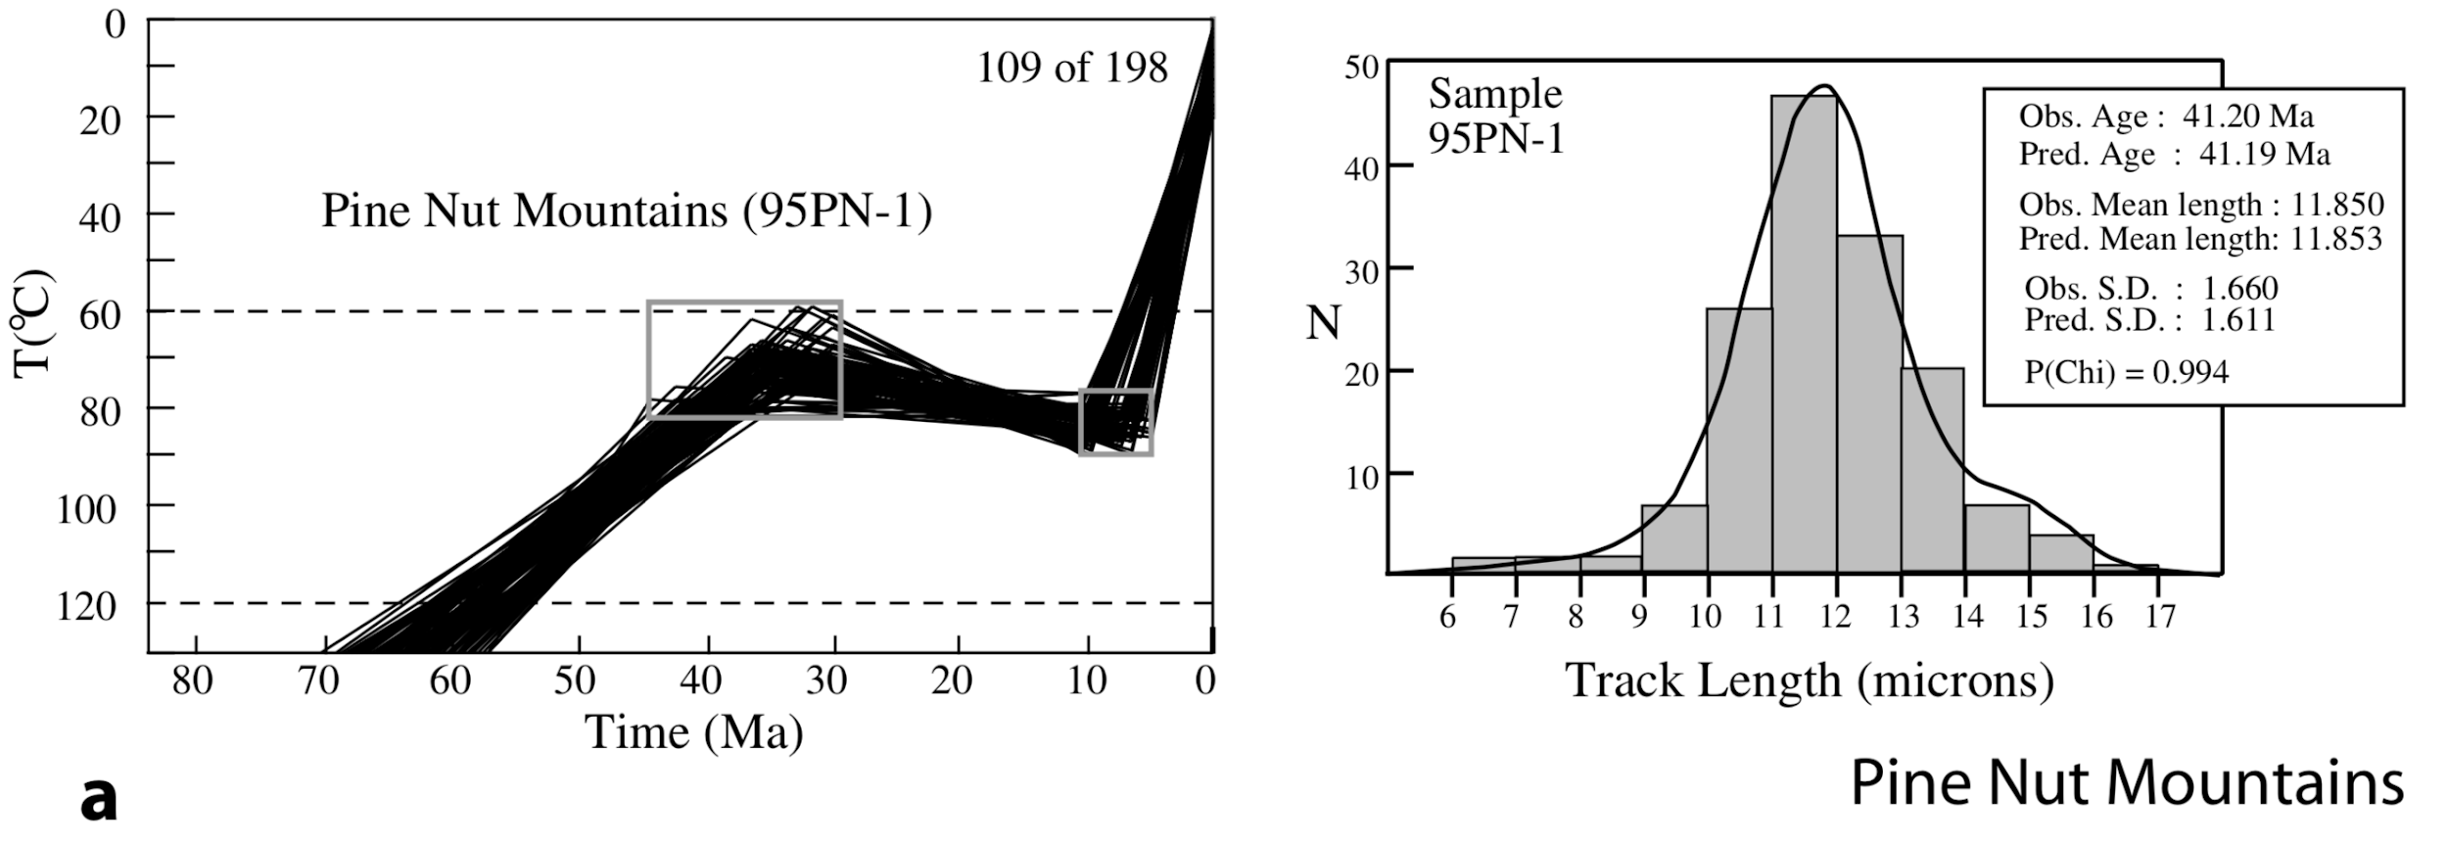
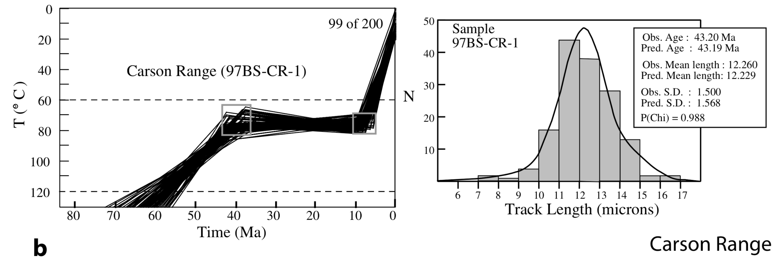
uplift
quiescence
uplift
uplift
quiescence
uplift
B. E. Surpless, et al., 2002
Based off: Monte Trax Program
Notes:
Since faulting did not expose rocks that were below the PAZ they had to use a different method to analyze their data
Monte Trax uses a monte carlo approach (uses repeaded random sampling of apparent age and track length to obtain thermal evolution of one sample)
Modeling suggest uplift from 70-30 corresponding to late cretaceous early tertiary erosional denudation from crustal thickening
Quiescence until 10Ma when the ranges undergo rapid cooling and exhumation

Slide 11
Extensional Deformation
Sierra Nevada Block is a rigid block that was uplifted during late Cenozoic times
Westernmost Basin and Range; boundary between two provinces
B. E. Surpless, et al., 2002
Notes:
Faulting in tahoe truckee depression results in shallow dips of late cenozoic volcanic rocks
Authors consider carson range western most basin and range and boundary between SN and BR province
However normal faulting keeps encroaching to the west of the tahoe truckee half grabben

Slide 12
Two Part Conclusion
Pt 1:
Mid Miocene extension in the East that agrees with onset of extension further East
Breakaway zone represents the boundary between extended and unextended terraines in the Miocene
Breakaway zone has migrated west to the Carson Range
Incipient faulting to West continues
B. E. Surpless, et al., 2002

Slide 13
Two Part Conclusion
But there are high geothermal gradients now, what changed?
Modeling: 70-30Ma cooling is likely from crustal thickening and broadly corresponds with laramide shallow angle subduction and low thermal gradients
AFT: Increase in temps @15 ma from advective heating resulting in andesite flows and possible trigger for extension
Why is faulting continuing to the West today?
B. E. Surpless, et al., 2002
Notes:
LEFT
Its likely that both the SN and SR were part of this low heat zone.
RIGHT
In their model, a thermal pulse weakens the cold crust beneath the Sierra Nevada Block causing failure and brittle faulting

Slide 14
References
Benjamin E. Surpless., Daniel F. Stockli., Trevor A. Dumitru., and Elizabeth L. Miller, Two Phase westward encroachment of the Basin and Range extension into the northern Sierra Nevada: Tectonics, vol.21, no. 1.
Daniel Doepke., 2017, Modelling the thermal history of onshore Ireland, Britain and its offshore basins using low temperature thermochronology: PhDThesis

